Slide 1
Big Data Analysis
Spark part 5

Slide 2
Spark 05 - TF-IDF

Slide 3
Lecture Objective
Understand the idea of TF-IDF
Explore the Spark TF-IDF
Hands-on program for TF-IDF

Slide 4
Ranked retrieval
Thus far, our queries have all been Boolean.
  Documents either match or don’t.
Good for expert users with precise understanding of their needs and the collection.
  Also good for applications: Applications can easily consume 1000s of results.
Not good for the majority of users.
  Most users incapable of writing Boolean queries (or they are, but they think it’s too much work).
  Most users don’t want to wade through 1000s of results.
    This is particularly true of web search.

Slide 5
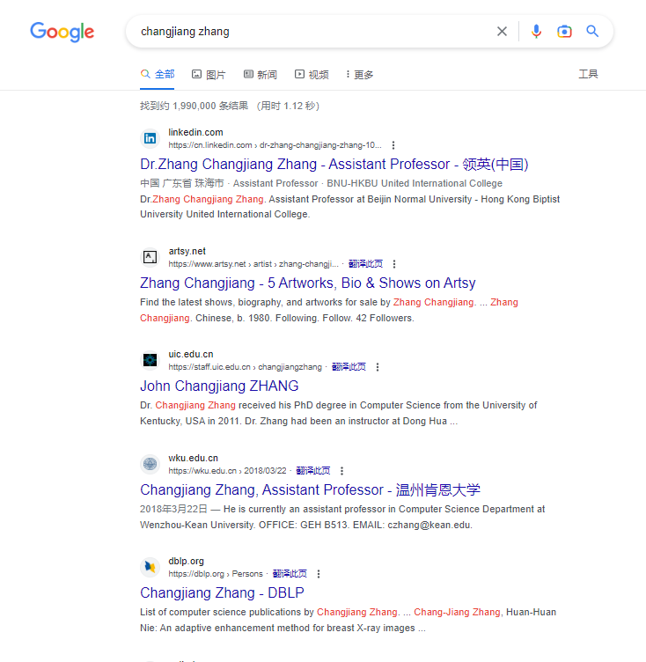

Slide 6
Ranked retrieval models
Rather than a set of documents satisfying a query expression, in ranked retrieval models, the system returns an ordering over the (top) documents in the collection with respect to a query
Free text queries: Rather than a query language of operators and expressions, the user’s query is just one or more words in a human language
In principle, there are two separate choices here, but in practice, ranked retrieval models have normally been associated with free text queries and vice versa

Slide 7
Feast or famine: not a problem in ranked retrieval
When a system produces a ranked result set, large result sets are not an issue
  Indeed, the size of the result set is not an issue
  We just show the top k ( ≈ 10) results
  We don’t overwhelm the user
  Premise: the ranking algorithm works

Slide 8
Scoring as the basis of ranked retrieval
We wish to return in order the documents most likely to be useful to the searcher
How can we rank-order the documents in the collection with respect to a query?
Assign a score – say in [0, 1] – to each document
This score measures how well document and query “match”.

Slide 9
Query-document matching scores
We need a way of assigning a score to a query/document pair
Let’s start with a one-term query
If the query term does not occur in the document: score should be 0
The more frequent the query term in the document, the higher the score (should be)
We will look at a number of alternatives for this.

Slide 10
Take 1: Jaccard coefficient
A commonly used measure of overlap of two sets A and B （Jaccard similarity coefficient）
jaccard(A,B) = |A ∩ B| / |A ∪ B|
jaccard(A,A) = 1
jaccard(A,B) = 0 if A ∩ B = 0
A and B don’t have to be the same size.
Always assign a number between 0 and 1.

Slide 11
Jaccard coefficient: Scoring example
What is the query-document match score that the Jaccard coefficient computes for each of the two documents below?
Query: book Psychoacoustics
Doc1: book hotel room
jaccard（ Query ， Doc1）=1/4
Doc2: journal paper Psychoacoustics study
jaccard（ Query ， Doc2）=1/5

Slide 12
Issues with Jaccard for scoring
It doesn’t consider term frequency (how many times a term occurs in a document)
Rare terms in a collection are more informative than frequent terms. Jaccard doesn’t consider this information
We need a more sophisticated way of normalizing for length
Later we’ll use instead of |A ∩ B|/|A ∪ B| (Jaccard) for length normalization.

Slide 13
Recall: Binary term-document incidence matrix
Each document is represented by a binary vector ∈ {0,1}^{|V|}

Slide 14
Term-document count matrices
Consider the number of occurrences of a term in a document:

Slide 15
Bag of words model
Vector representation doesn’t consider the ordering of words in a document
John is quicker than Mary and Mary is quicker than John have the same vectors
This is called the bag of words model.
In a sense, this is a step back: The positional index was able to distinguish these two documents.
We will look at “recovering” positional information later. For now: bag of words

Slide 16
Term frequency tf
The term frequency tf_{t,d} of term t in document d is defined as the number of times that t occurs in d. （same as word count）
We want to use tf when computing query-document match scores. But how?
Raw term frequency is not what we want:
  A document with 10 occurrences of the term is more relevant than a document with 1 occurrence of the term.
  But not 10 times more relevant.
Relevance does not increase proportionally with term frequency.
NB: frequency = count

Slide 17
Log-frequency weighting
The log frequency weight of term t in d is
0 → 0, 1 → 1, 2 → 1.3, 10 → 2, 1000 → 4, etc.
Score for a document-query pair: sum over terms t in both q and d:
score
The score is 0 if none of the query terms is present in the document.

Slide 18
Document frequency
Rare terms are more informative than frequent terms
  Recall stop words
Consider a term in the query that is rare in the collection (e.g., liquidator)
A document containing this term is very likely to be relevant to the query liquidator
→ We want a high weight for rare terms like liquidator.

Slide 19
Document frequency, continued
Frequent terms are less informative than rare terms
Consider a query term that is frequent in the collection (e.g., high, your, line)
A document containing such a term is more likely to be relevant than a document that doesn’t
But it’s not a sure indicator of relevance.
→ For frequent terms, we want high positive weights for words like high, your, and line
But lower weights than for rare terms.
We will use document frequency (df) to capture this.

Slide 20
idf weight
df_{t} is the document frequency of t: the number of documents that contain t
  df_{t} is an inverse measure of the informativeness of t
  df_{t} ≤ N
We define the idf (inverse document frequency) of t by
  We use log (N/df_{t}) instead of N/df_{t} to “dampen” the effect of idf.

Slide 21
Effect of idf on ranking
Does idf have an effect on ranking for one-term queries, like
  iPhone?
idf has no effect on ranking one term queries
  idf affects the ranking of documents for queries with at least two terms
  For the query capricious person, idf weighting makes occurrences of capricious count for much more in the final document ranking than occurrences of person.

Slide 22
tf-idf weighting
The tf-idf weight of a term is the product of its tf weight and its idf weight.
Best known weighting scheme in information retrieval
  Note: the “-” in tf-idf is a hyphen, not a minus sign!
  Alternative names: tf.idf, tf x idf
Increases with the number of occurrences within a document
Increases with the rarity of the term in the collection

Slide 23
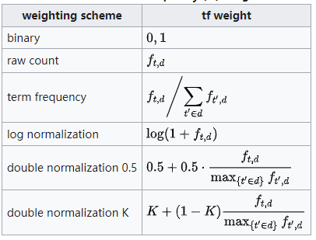
Calculate tf
Variants of term frequency (tf) weight

Slide 24
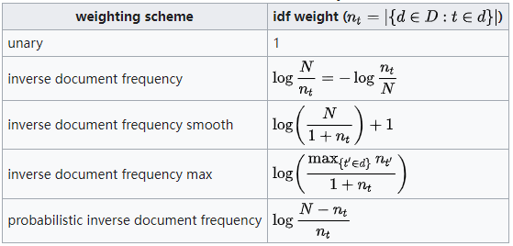
Calculate idf
Variants of inverse document frequency (idf) weight

Slide 25
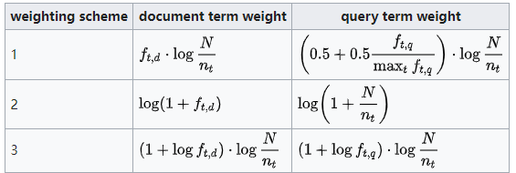
Calculate tf-idf
Term frequency–Inverse document frequency(tf-idf)
is calculated as:
Recommended tf–idf weighting schemes

Slide 26
Final ranking of documents for a query

Slide 27



TF-IDF
How to calculate td-idf
tf–idf - Wikipedia
Step 1: calculate TF
TF=1+log(wc)
Step 2: calculate IDF
or
Step 3: calculate TF-IDF

Slide 28
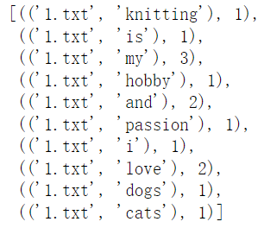
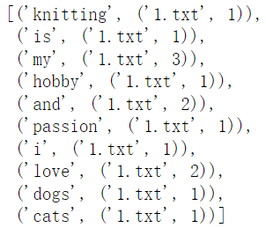
LabS05_1 – TF-IDF
Refer to the code: LabS05_1_TFIDF
Step 1: calculate TF
from pyspark import SparkConf, SparkContext
import os, re
sc = SparkContext.getOrCreate(SparkConf())
data = sc.wholeTextFiles(‘data/iitfidf')
numFiles = data.count()
wordcount = data.flatMap(lambda x: [((os.path.basename(x[0]), i), 1) \
for i in re.split('\\W', x[1])]) \
.reduceByKey(lambda a, b: a + b)
wordcount.take(10)
tf = wordcount.map(lambda x: (x[0][1],(x[0][0],x[1])))
tf.take(10)

Slide 29
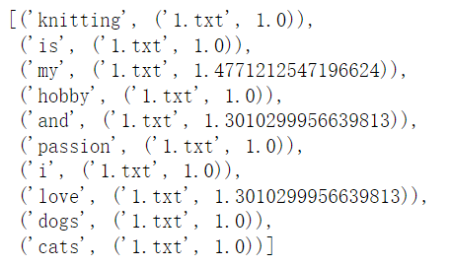
LabS05_1 – TF-IDF
Refer to the code: LabS05_1_TFIDF
Step 1: calculate TF
TF=1+log(wc)
import math
tf2 = tf.map(lambda x: (x[0],(x[1][0], 1+math.log10((x[1][1]) ))))
tf2.take(20)

Slide 30
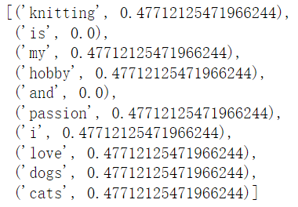
LabS05_1 – TF-IDF
Refer to the code: LabS05_1_TFIDF
Step 2: calculate IDF
import math
idf = wordcount.map(lambda x: (x[0][1], 1)))\
.reduceByKey(lambda x, y: x + y)\
.map(lambda x: (x[0], math.log10(numFiles / (x[1]))))
idf.take(10)

Slide 31
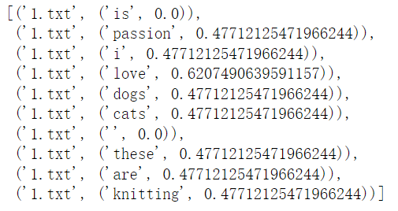
LabS05_1 – TF-IDF
Refer to the code: LabS05_1_TFIDF
Step 3: calculate TF-IDF
tfidf = tf.join(idf)\
.map(lambda x: (x[1][0][0], (x[0], x[1][0][1] * x[1][1])))\
.sortByKey()
tfidf.take(10)

Slide 32
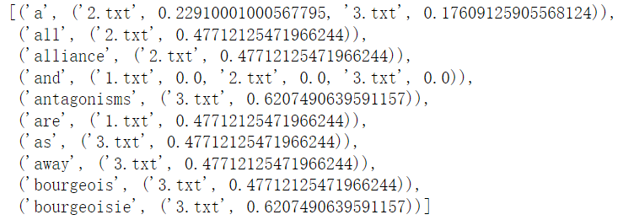
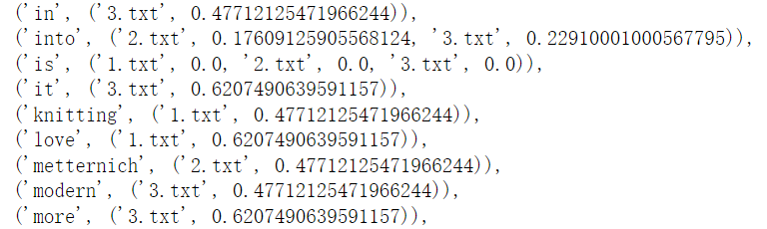
LabS05_1 – TF-IDF
Refer to the code: LabS05_1_TFIDF
Step 4: build an index
index = tfidf.map(lambda x:(x[1][0], (x[0], x[1][1]))).filter(lambda x: x[0]!='')
index = index.reduceByKey(lambda a,b:a+b).sortByKey()
index.take(10)
Not sorted yet

Slide 33
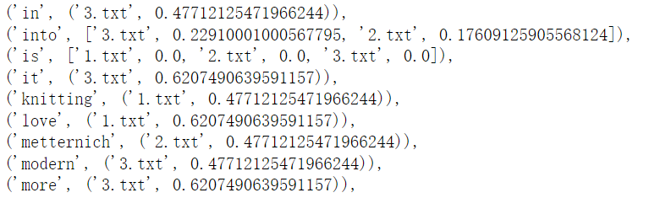
LabS05_1 – TF-IDF
Refer to the code: LabS05_1_TFIDF
Step 5: sort the list
import operator
def InvSort(x):
if(len(x)<=2):
return x
# implement your code here
return x
index2 = index.map(lambda x: (x[0], InvSort(x[1])))
index2.take(100)

Slide 34
TF-IDF in Spark
Spark provides a neat machine learning library for TF-IDF:
  First use the Tokenizer
  Then TF with hashed word vector/count
  Then calculate IDF and output results

Slide 35
LabS05_2 – Spark TF-IDF
Refer to lab code: (LabS05_2_SparkTFIDF)
from pyspark.sql import SparkSession
from pyspark.ml.feature import HashingTF, IDF, Tokenizer
spark = SparkSession.builder.appName('spark_tfidf').getOrCreate()
sentenceDataFrame = spark.createDataFrame([
(0.0, 'Hi I love UIC love love love'),
(1.0, 'I wish I could stay in UIC forever'),
(2.0, 'The UIC Data Science Programme is awesome')], ['label', 'sentence'])
sentenceDataFrame.show(truncate=False)
tokenizer = Tokenizer(inputCol = 'sentence', outputCol = 'words')
word_df = tokenizer.transform(sentenceDataFrame)
word_df.show(truncate=False)
hashing_tf = HashingTF(inputCol = 'words', outputCol = 'rawFeatures')
featurized_df = hashing_tf.transform(word_df)
featurized_df.show(truncate=False)
idf = IDF(inputCol = 'rawFeatures', outputCol = 'features')
idf_model = idf.fit(featurized_df)
rescaled_df = idf_model.transform(featurized_df)
rescaled_df.show(truncate=False)

Slide 36
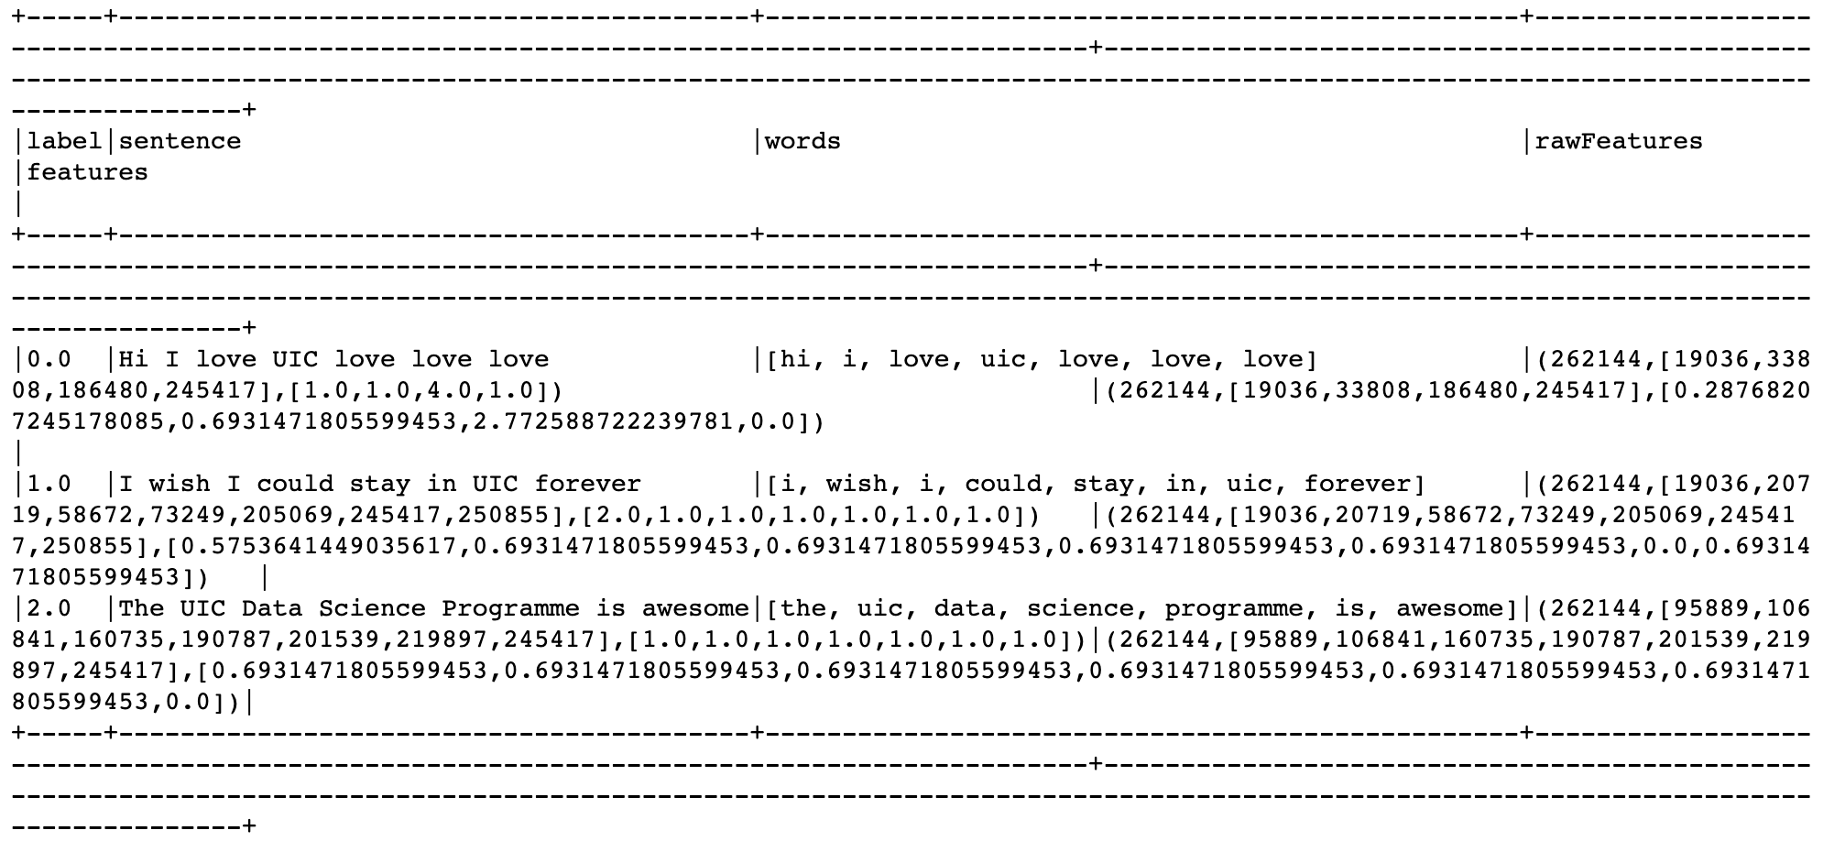
LabS05_2 – Spark TF-IDF
Refer to lab code:
  LabS05_2_SparkTFIDF

